Slide 1


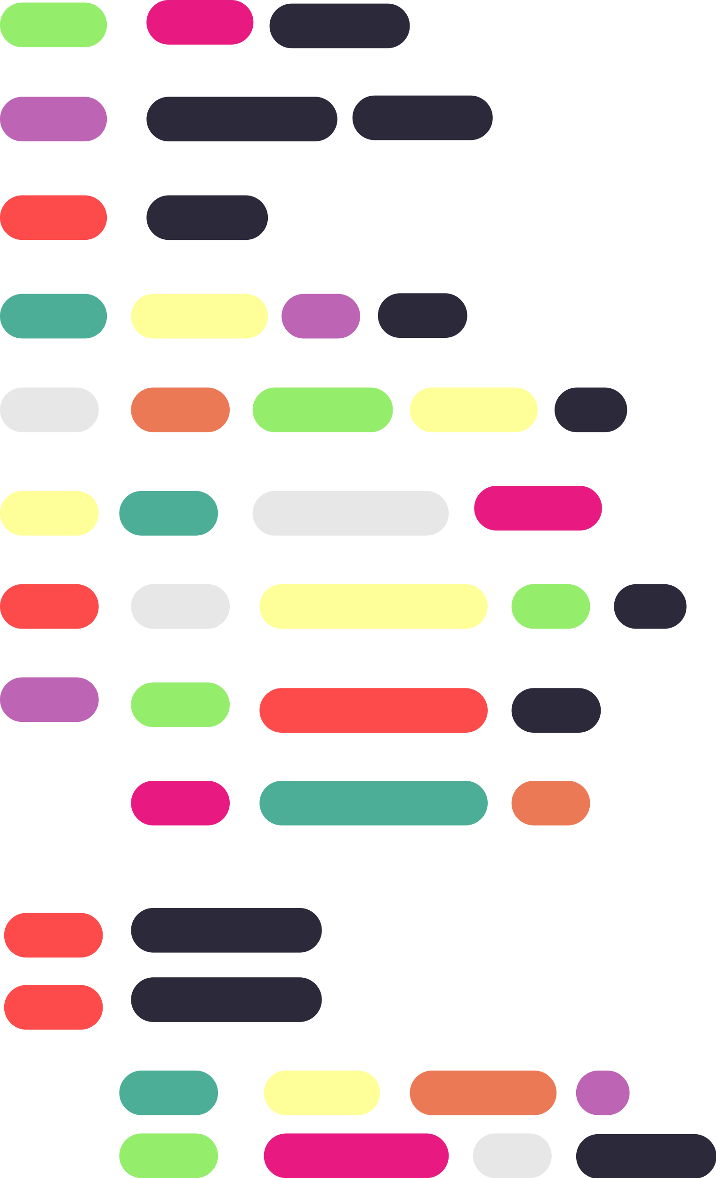
{
Branch and Bound
< Competitive Programming Day-6 >
}
...

Slide 2
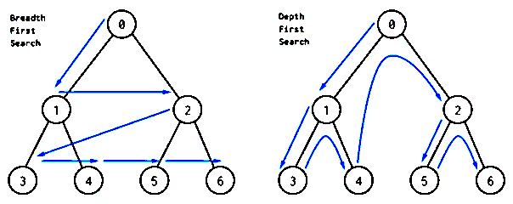
DFS and BFS
{
..
Before delving into Branch and Bound, it's important to grasp two essential algorithms: `Depth First Search (DFS)` and `Breadth First Search (BFS)`.
BFS is another graph traversal technique. It explores all neighbours at the current level before moving to the next level
DFS on the other hand, is a graph traversal method where you start at a node, delve as deep as possible along each branch, and backtrack when necessary.
}
..

Slide 3

Branch and Bound
This is an algorithmic approach for optimizing complex problems by systematically exploring the solution space while eliminating unpromising branches. algorithmic approach for optimizing complex problems by systematically exploring the solution space while eliminating unpromising branches.
Initialization: Start with an initial feasible solution (if available) and an upper bound.
Branching: Divide the problem into smaller branches, representing different choices, and explore them systematically.
Bounding: Calculate lower bounds for branches and prune those worse than the current upper bound.
Exploration: Explore branches based on priority (often using a priority queue) determined by lower bounds.
Update Bounds: Continuously update upper and lower bounds, adjusting the upper bound if a better solution is found.

Slide 4
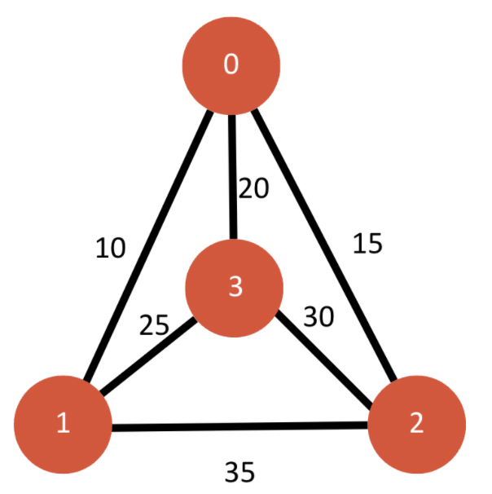
Branch and Bound
6.Pruning: Remove branches that won't lead to better solutions than the current upper bound or are infeasible.
7.Termination: Continue exploration until branches are pruned or a predefined stopping criterion is met.
8.Solution Retrieval: The best solution found (the upper bound) represents the optimal solution.
In summary, Branch and Bound is a technique for optimization involving branching (generating subproblems), a state space tree (exploring all possible paths), and the extension of the most promising options while discarding less favourable ones through pruning.

Slide 5
Example
Travelling Salesman Problem
The Traveling SalesmanProblem (TSP) involves finding the shortest tour that visits every city exactly once and returns to the starting city.

Slide 6
Example
Lower Bound: Calculate a lower bound that represents the best possible solution achievable by adding edges through each city.
Initialization: Set up variables for path tracking, visited cities, and minimum cost. Calculate an initial lower bound by summing two minimum edge costs for each city and halving the result.
Exploration Start: Begin with a starting city (usually 0), mark it visited, and initialize the exploration.
Recursive Exploration: For the current city, consider unvisited cities as potential destinations. Calculate a lower bound for the current node. If it's better than the best solution found so far, explore this branch recursively. Backtrack when needed.
Base Case: When all cities are visited, check if there's an edge back to the start. If yes, calculate the tour's cost and update the best solution.
Rounding Lower Bound: Ensure the lower bound is an integer. Round differently based on the exploration level.
Final Result: After exploring all paths, the final result contains the minimum cost and the corresponding path.
Travelling Salesman Problem

Slide 7
